Slide 1

Commercial Mortgage Loan Accounting System
A Project by Adam Slager
SOFTWARE SYSTEM DESIGN, SWENG 837

Slide 2
Problem statement and requirements
Company Background
Note: The following document uses the example of The Commercial Mortgage Corporation throughout. All situations are fictional, and the company does not exist.
The Commercial Mortgage Corporation is a commercial mortgage loan (“loan”) originator and servicer that was founded in the early 1990’s.
Recent Growth:
Entered new territories
Hired a team of experienced originators and support staff (accountants, treasury analysts, and loan analysts)
Origination volume has nearly doubled
Servicing portfolios are growing at a rate of 20 percent per year.

Slide 3
Problem statement and requirements
Problem Description
Symptoms:
Several month-end closes were delayed due to errors found in spreadsheet formulas.
Financial statements had to be reissued due to a material error in calculating loan losses.
Major default event for a large Loan was missed, due to a lack of communication between the credit officer and the loan team
KPI’s related to the timeliness of accounting functions have been increasing substantially
Causes:
Over the course of several months, management team and ownership group investigated
Software being used by the Company was primary cause
Spreadsheets and a Microsoft Access Database to keep track of the accounting, servicing, and analytics of its Loan portfolio
The spreadsheets are unwieldy and prone to error and the Access Database is slow and cumbersome to use.
The two are not connected and significant time is spent reconciling them during period closes.
Desired Outcomes:
Reduce time spent on issues related to poor systems
Single source of truth for all aspects of loan accounting and servicing

Slide 4
Problem statement and requirements
System Functionality Required
Record Keeping - Track all key aspects of the loan from origination until its ultimate satisfaction or termination
Loan Details – Includes all loan closing information, such as loan amount, interest rate, fees, and pertinent dates.
Loan Financial Information – Information about the underlying financial performance of the loan that is updated at defined periods. This includes most information that a Credit Officer would be responsible for monitoring, such as covenants, data input from financial statements, default information, etc.
Collateral Details – Information about the underlying property collateralizing the mortgages, including appraised value, property description, etc.
Amortization Schedule – Includes all information pertinent to creating a loan amortization schedule.
Billing- The System is required to create invoices for Borrowers and automatically send those invoices via email.
Portfolio Level Accounting – The System is required to provide all functions of a subledger for mortgages. This includes:
Calculations – The System will calculate all pertinent revenue, cash flows, losses, amortization, etc.
Journal Entries – The System will create all required journal entries for the above calculated amounts
Interface with Corporate Accounting – After review, the System will interface with the Corporate Accounting System on a periodic basis (coinciding with monthly/quarterly accounting closes) and send complete journal entries to the Corporate Accounting System.

Slide 5
Problem statement and requirements
System Functionality Required (Continued)
Portfolio Monitoring - The System will provide a dashboard for the Credit Officers, allowing for the following:
Credit Information – The Dashboard will display views related to individual credits that both detail and summarize pertinent information, such as trends in loan financial information, covenants, etc.
Credit Commentary – The Dashboard will provide functionality for the Credit Officers to write detailed commentary about the Loan. The Credit Officers will be able to tag other uses in the commentary. These users (who may not be frequent users of the System, such as upper management) will be sent copies of the commentary via email. The System will interface directly with the email system to send the commentary.
Treasury Management- The System will provide functionality for the Treasury department:
Forecast incoming cash flows - A primary function of Treasury is to ensure that cash is managed properly (anticipating cash flows, rightsizing borrowings, ensuring sufficient cash on hand for fundings). The System will provide Treasury with forecasted cash flow information.
Interaction with Banking System - The System will allow Treasury to directly upload cash flow data into the bank’s system. Using the bank’s tools (external to the System), treasury will be able to automatically match actual cash movements with forecasted cash.
Data Entry - The System will provide a user interface to input data and manage loans, which will be intuitive and promote efficiency.

Slide 6
Problem statement and requirements
Target Users and Needs (Primary)
Type | Actor | Goal Description
Primary | Loan Analyst | The Loan Analyst wants to use the System to input Mortgage attributes after loan closing and update any loan attributes after amendments.
Primary | Loan Accountant | The Loan Accountant wants to use the system to generate journal entries and revenue, expense, and cash flow reports for the population of mortgages (the “Portfolio”) and to have the System feed into the corporate accounting system.
Primary | Billing Analysts | The Billing Analysts want to use the System to generate and send invoices for Loan borrowers (the “Customers”).
Primary | Treasury Analysts | The Treasury Analysts want to use the System to generate cash flow files for forecasting and to upload them to banking software.
Primary | Credit Officers | Credit Officers want to use the System to review data related to the Customer’s financial position and credit worthiness and the Loan collateral’s value. They also want to utilize the System to view loan dashboards and add commentary.

Slide 7
Problem statement and requirements
Target Users and Needs (Supporting)
Type | Actor | Goal Description
Supporting | Corporate Accounting System | The Corporate Accounting System is an external system that wants to use journal entries generated by the System to consolidate into the main general ledger.
Supporting | Email System | The Email System is an external system that wants to send invoices, messages, and attachments from the System to internal and external parties.
Supporting | Reporting System | The Reporting System is an external system that wants to use the data produced by the System to create analytics, reports, and dashboards.
Supporting | Banking Software | The Banking Software is an external system (or multiple systems) that wants to use the data generated by the system for account reconciliation.
Supporting | System Administrator | The System Administrator wants the System to remain running and error free and to help users when errors do arise.

Slide 8
Problem statement and requirements
Target Users and Needs (Offstage)
Type | Actor | Goal Description
Offstage | Loan Closing Team | The Loan Closing Team wants to ensure that all relevant information from the loan closing process is accurately input into the System, as the loan performance influences their financial targets and compensation.
Offstage | Legal Department | The Legal Department wants to be notified of any defaulting loans by Credit Officers and Management to begin remediation.
Offstage | Customers (Borrowers) | The Customers want to receive accurate billing statements from the System.
Offstage | Corporate Accounting Team | The Corporate Accounting team wants to utilize the information generated by the System as an asset subledger and to be able to rely on the accuracy of the data produced.
Offstage | Management Team/Owners of Company | The Management Team/Owners of the Company want to ensure that the System is efficient, accurate, and scalable. They want to ensure that it helps facilitate existing processes and that it can adapt to accommodate new ones.
Offstage | External Auditors | External auditors want to be able to utilize and rely on the output of the System. They want to be able to test the System for controls reliance and to be able to generate required reports for their audit procedures.
Offstage | Financial Regulators | Financial regulators want to ensure that the System is accurate from both a billing and financial reporting perspective, to protect the Customers and those parties that would rely on the financial information that it produces.

Slide 9
Problem statement and requirements
Business Goals that the System is Required to Support
Goal | How System Supports Goal
Shortening monthly accounting close time by two days and Quarterly accounting close time by three days within next two years | Efficiencies created by combining disparate systems, ease of use with user interface design, and error prevention through carefully design calculations and automatic journal entry generation.
Supporting increased originations of 20 percent annually and servicing portfolio growth of a similar degree. | Efficiencies created by ease of training and use, performance of system, and scalable design.
Supporting the potential acquisition of a smaller competitor within the next five years | Scalable design, ease of use, and use of GRASP techniques for interoperability.
Decreasing the processing time of financial information received from borrowers by 50 percent within the next three years. | Efficiencies created by moving onto a modern system, including modern GUI, system response time, and built in workflows.
Zero financial statement reissuance due to accounting errors | Similar to shortening the monthly accounting close, the system will support accuracy by implementing error prevention through carefully design calculations and automatic journal entry generation.
Decrease in realized losses of 10 percent in the next three years | Integrating loan credit reporting directly into the System and decreasing time in processing borrower financial information (as per above).
Shortening loan onboarding process by 25 percent over the next three years | Similar to processing financial information, efficiencies will be created by moving onto a modern system, including modern GUI, system response time, and built in workflows.

Slide 10
Problem statement and requirements
Non-Functional Requirements
Performance Requirements
Security Requirements
NFR Type | NFR Description
Response Time | 95% of user requests must be processed and returned in under 1 second
Scalability | 100 concurrent users must be supported without any noticeable performance degradation (this is equal to the maximum concurrent users expected for the System plus a buffer as per Management).
Throughput / Transactions Per Second | The System shall process a minimum of 50 transactions per second
Latency | Round Trip Time (RTT) shall not exceed 100ms for 95 percent of transactions
NFR Type | NFR Description
Authentication | The System shall incorporate MFA authentication to ensure that a user’s identity is verified The System shall meet or exceed ISO 27001 standards for password policies.
Authorization | System shall implement a RBAC solution to control access to sensitive or privileged data
Data at Rest Encryption | AES-256 or greater
Data in Transit Encryption | TLS 1.2 or greater
Firewall | Web application firewall required that meets or exceeds all GDPRS and ISO 27001 standards
GDPRS Requirements | System shall meet or exceed all GDPRS requirements

Slide 11
Problem statement and requirements
Non-Functional Requirements (Continued)
Maintainability Requirements
NFR Type | NFR Description
Code Modularity | The code base shall be segregated into logical and independent modules or components to facilitate testing and maintainability.
Documentation | The System design and code shall be documented in a clear and concise manner using an online blog format such as GitHub Markdown, in-line documentation, and use cases. Code shall be documented within individual code files so that a junior developer can understand the purpose of 95 percent of code within 5 minutes of analyzing it. APIs shall be documented via Swagger.
Testing Strategy | Unit Test Coverage: At least 80 percent of code base should be covered using Unit Tests using a framework such as Jest, Jasmine, Junit, etc. System Testing: System testing shall be performed using a framework such as Cyprus or Selenium Unit and System Testing shall be automated using a CI/CD workflow such as GitHub Actions. API Testing shall be automated using a framework such as Postman Logging and Monitoring shall be consolidated using a tool such as Splunk Performance testing shall test the response time of the System under normal and peak loads using automated toolsets. User Acceptance Testing shall be based on Use Cases and any user stories and shall be run prior to System go-live.

Slide 12
Problem statement and requirements
Non-Functional Requirements (Continued)
Other Requirements
NFR Type | NFR Description
Availability | The System shall maintain 99.9% availability between the hours of 7am EST and 11pm EST on weekdays and 99% availability otherwise (excluding scheduled maintenance windows)
Recovery Time Objective (RTO) | 4 Hours (System is considered mission critical by Management)
Recovery Point Objective (RPO) | 30 Minutes (Due to the transactional nature of the business, any data loss of greater than 30 minutes is deemed unacceptable by Management)
Data Retention | All data must be retained for a minimum of seven years in accordance with the Company’s data retention standards

Slide 13
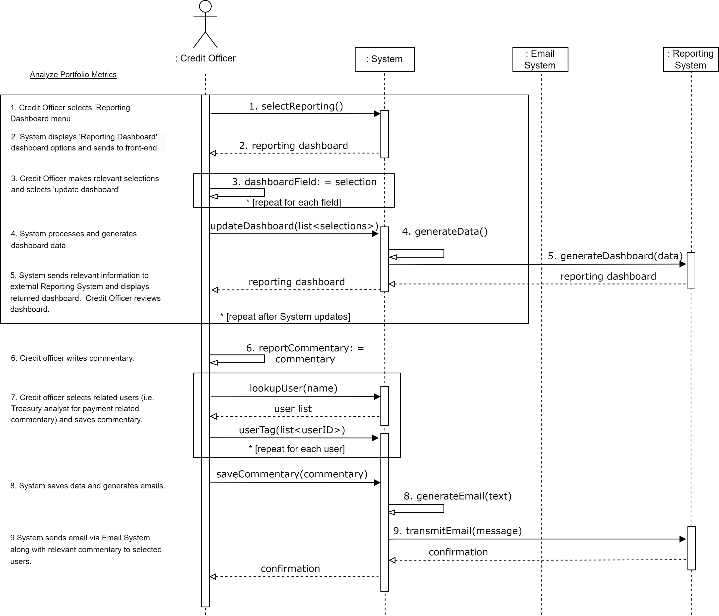
Uml System Sequence Diagrams analyze portfolio metrics

Slide 14
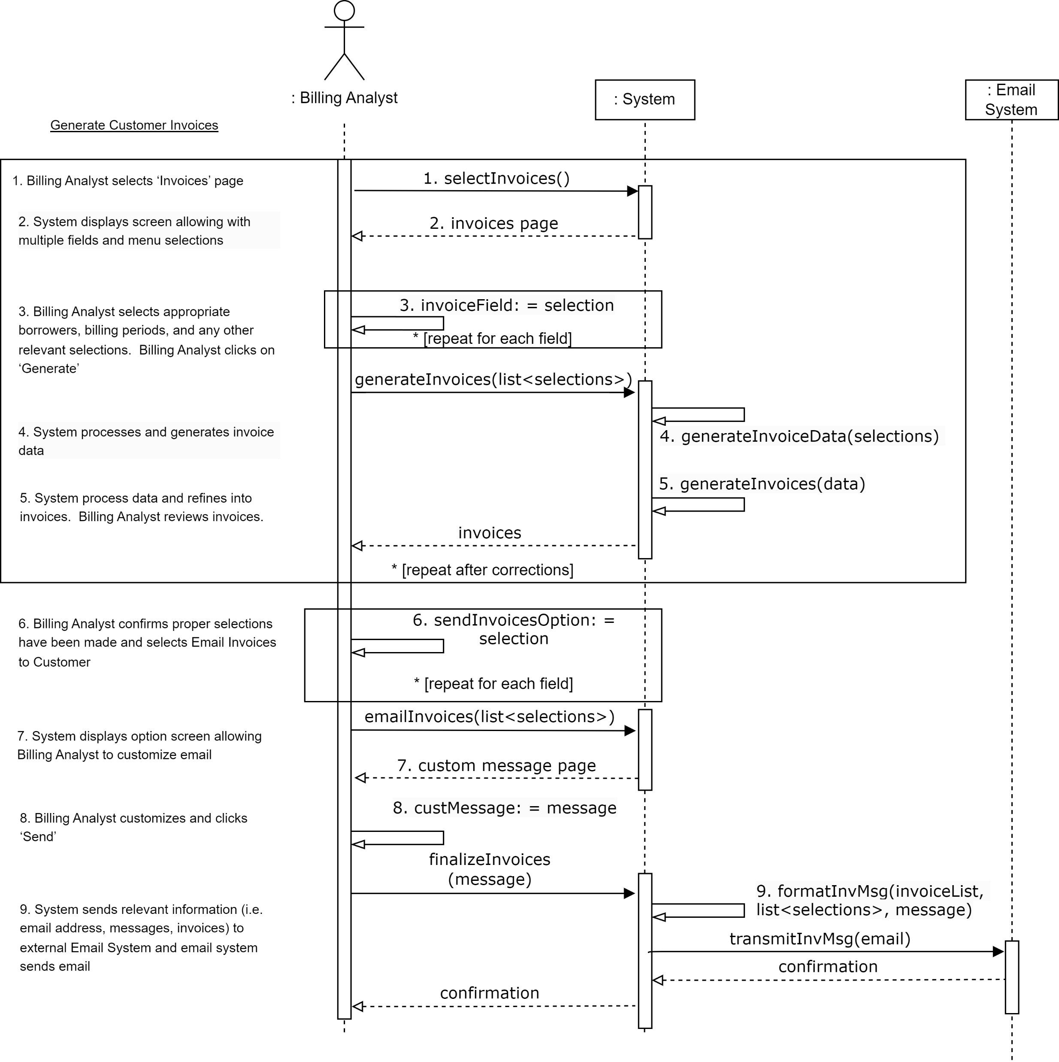
Uml System Sequence Diagrams generate customer invoices

Slide 15
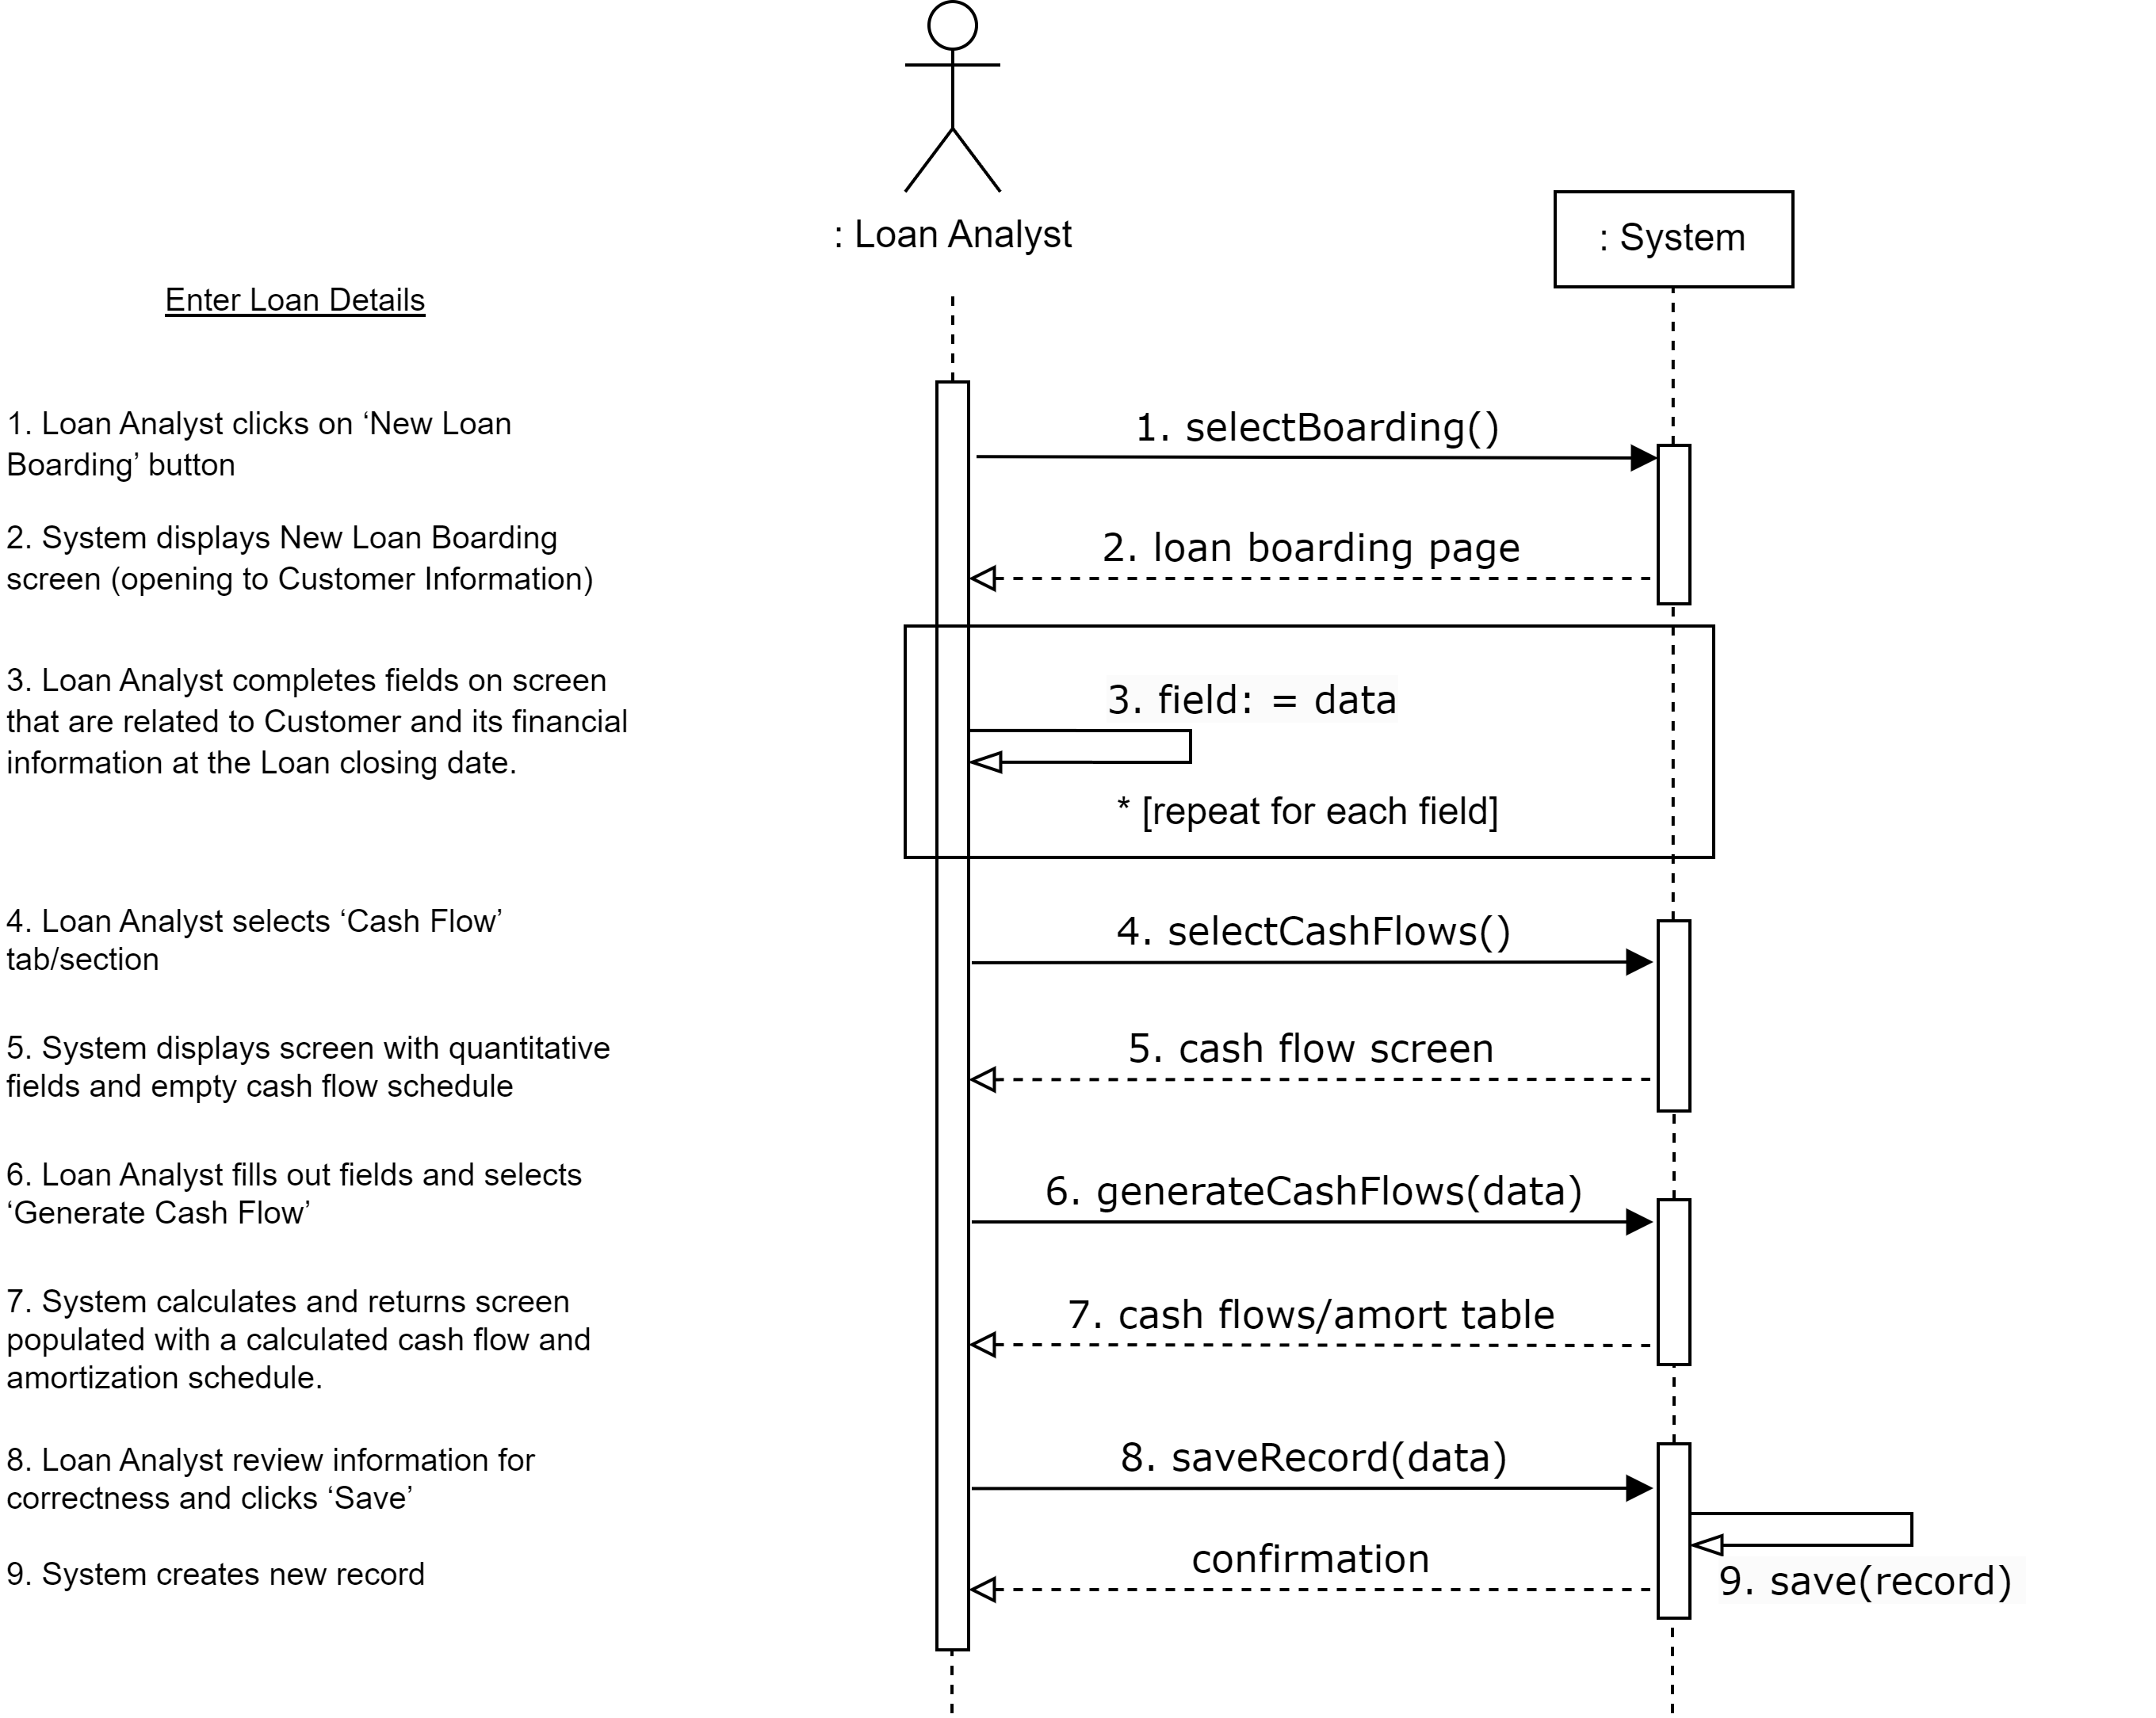
Uml System Sequence Diagrams Enter Loan Details

Slide 16
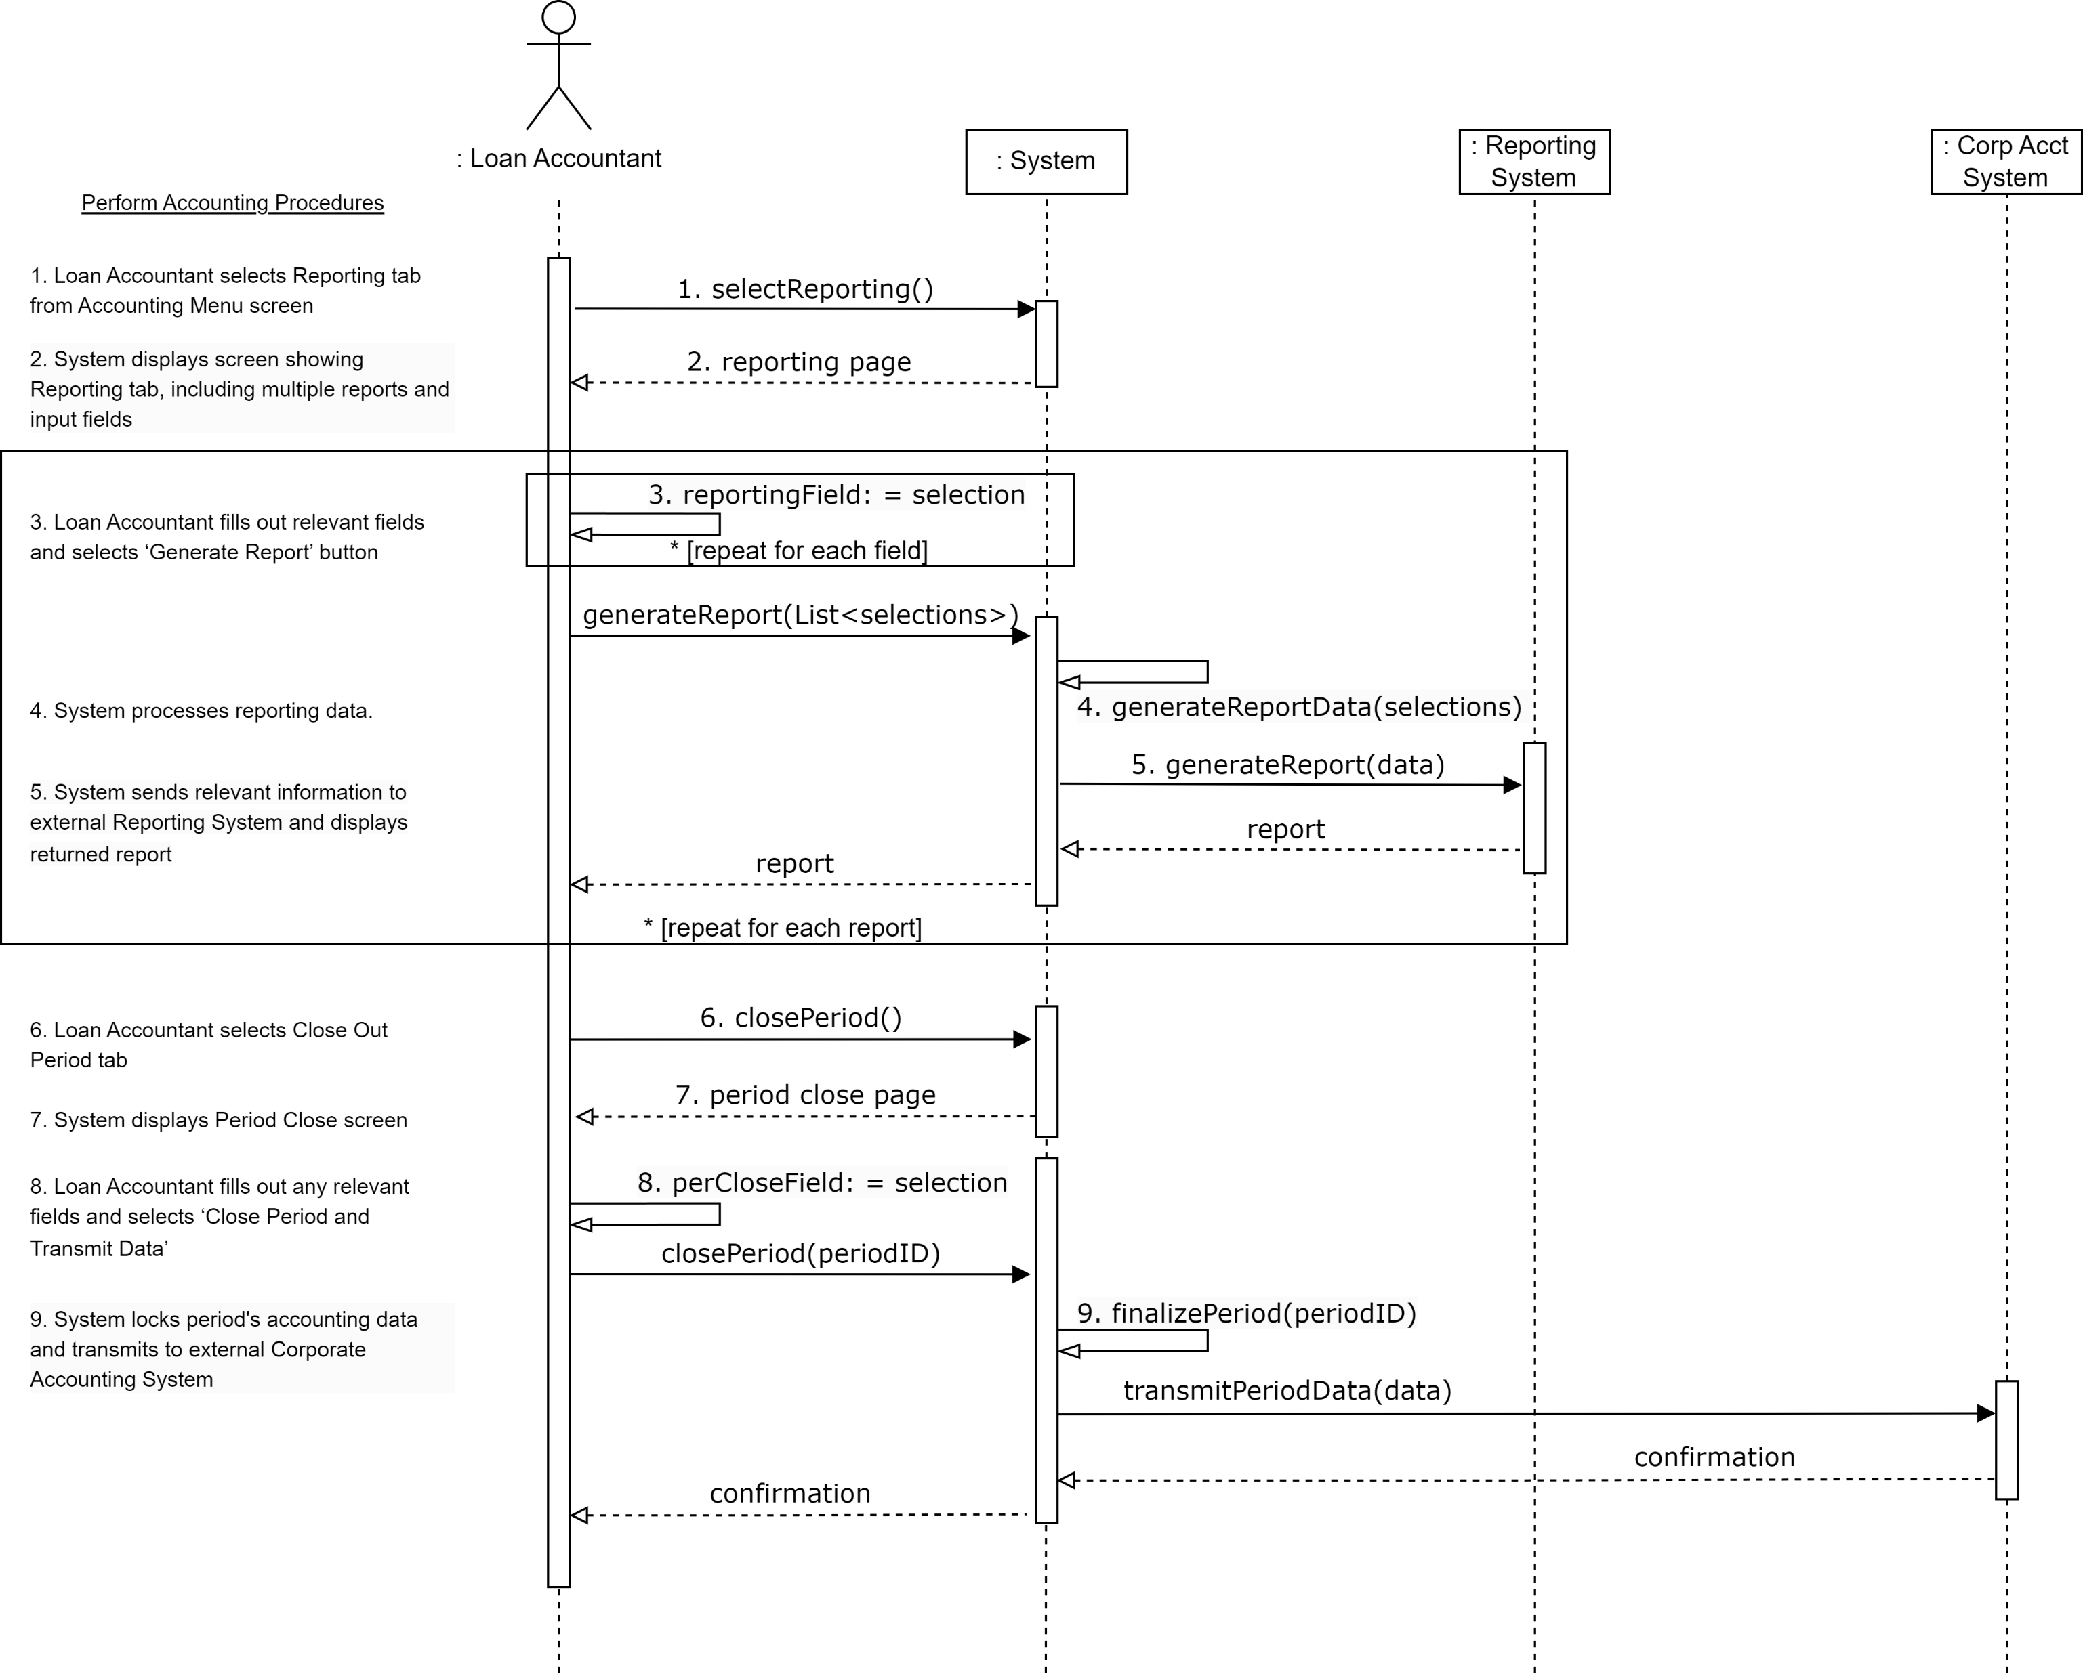
Uml System Sequence Diagrams Perform Accounting procedures

Slide 17
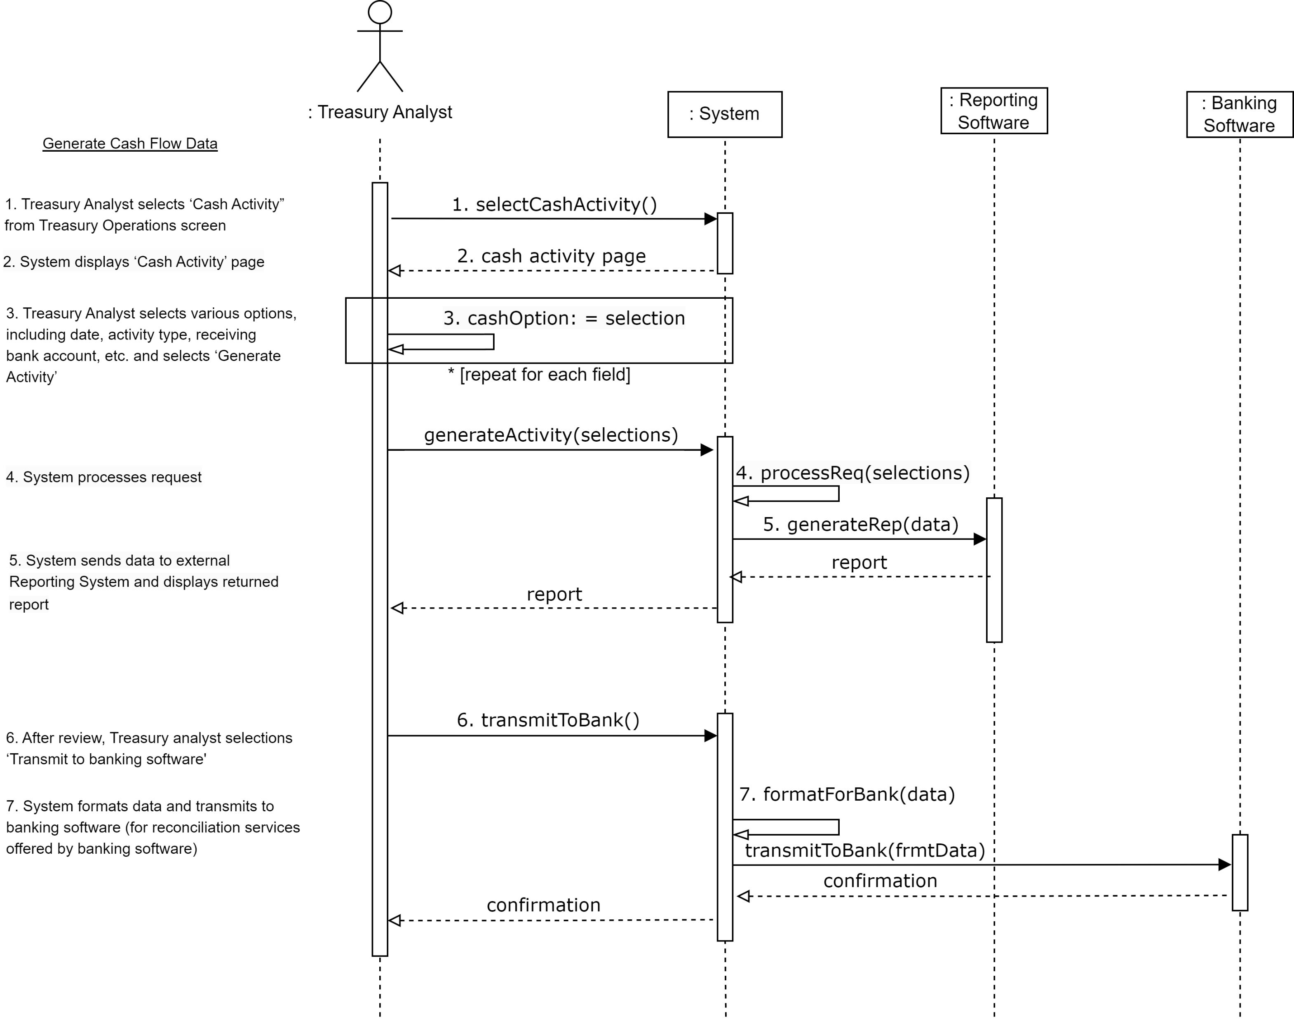
Uml System Sequence Diagrams Generate Cash Flow Data

Slide 18
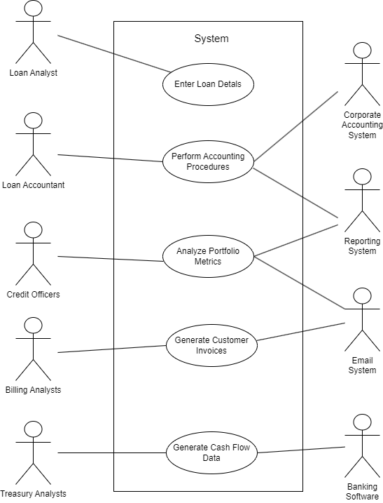
Uml Use case diagram

Slide 19
Uml conceptual classes
Conceptual Class Category | Conceptual Class Example
Physical or Tangible Objects | Collateral
Specifications, Designs or Descriptions of Things | Loan Details, Commentary
Places | Collateral, Borrower Business Address
Transactions | Loan Closing, Invoice, Loan Payoff, Loan Default
Transaction Line Items | Monthly Interest, Monthly Principal, Principal Remaining, Closing Fees, Ongoing Fees
Roles of People | Loan Analyst, Loan Accountant, Billing Analyst, Credit Officer, Treasury Analyst, Customer Contact, Auditor, Regulatory, Management, Legal, User
Containers of Other Things | Invoice, Journal Entry, Dashboard, Portfolio, Cash Flows, Database
Things in a Container | Loan (Portfolio), Principal Due (Invoice), Interest Due (Invoice), Journal Entry (Accounting Report), Journal Entry Line Items (Journal Entry), Loan Covenants (Loan Credit Analysis), Cash Flow Line Item
Other Computers/Systems (external) | Reporting System, Corporate Accounting System, Email System, Banking Software
Abstract Noun Concepts | Interest Rate, Financial Information, Loan Covenants, Dashboard, Commentary, Borrower, Amortization, Loan Details
Organizations | SEC
Events | Default, Accounting Close, Foreclosure, Loan Closing
Processes | Banking System Transmission, Accounting System Transmission, Email System Transmission, Reporting System Transmission
Rules and Policies | GAAP, Dodd-Frank Act, AML Policies
Catalogs | General Ledger Account Catalogue, Consolidation Tree
Records of Finance, Work, Contracts, Legal Matters | Invoice, Loan Documentation, Commentary, Loan Covenants
Financial Instruments and Services | Commercial Mortgage Loan
Manuals, Books, Documents, Reference Papers | Loan Documentation

Slide 20
Uml conceptual classes pruning
Kept Classes
Address (Shortened from Borrower Business Address), Amortization Line Item, Amortization Schedule, Banking Software, Billing Analyst, Borrower, Cash Flow Line Item, Cash Flows, Collateral, Commentary, Corporate Accounting System (renamed to Corp Acc Sys Gateway), Credit Officer, Customer Contact, Dashboard, Database (renamed to Database Access) Email System (renamed to Email Gateway), Financial Information, Invoice, Journal Entry, Journal Entry Line Items, Loan, Loan Accountant, Loan Analyst, Loan Details, Portfolio, Reporting System (Renamed to Reporting Sys Gateway), Treasury Analyst, User
Pruned Classes
Irrelevant Classes
The following classes were pruned because they are not relevant as classes in the System or because they are not Primary or Supporting Actors: GAAP, Dodd-Frank Act, AML Policies, SEC, Loan Documentation, Consolidation Tree, Auditor, Regulatory, Management, Legal
Implementation Specific
The following classes represent processes that will occur and will be captured in the Banking, Reporting, Accounting, and Email Gateway classes: Banking System Transmission, Accounting System Transmission, Email System Transmission, Reporting System Transmission
Attributes
The following concepts (or modifications thereof) are used as attributes in the System: Interest Rate, Loan Covenants, Default, Accounting Close, Foreclosure, Loan Closing, General Ledger Account Catalogue, Principal Due, Interest Due, Loan Payoff, Principal Remaining, Closing Fees, Ongoing Fees
Redundant Classes
The following redundant classes were pruned: Monthly Interest (Redundant with Interest Due), Monthly Principal (Redundant with Principal Due), Commercial Mortgage Loan (Redundant with Loan)

Slide 21
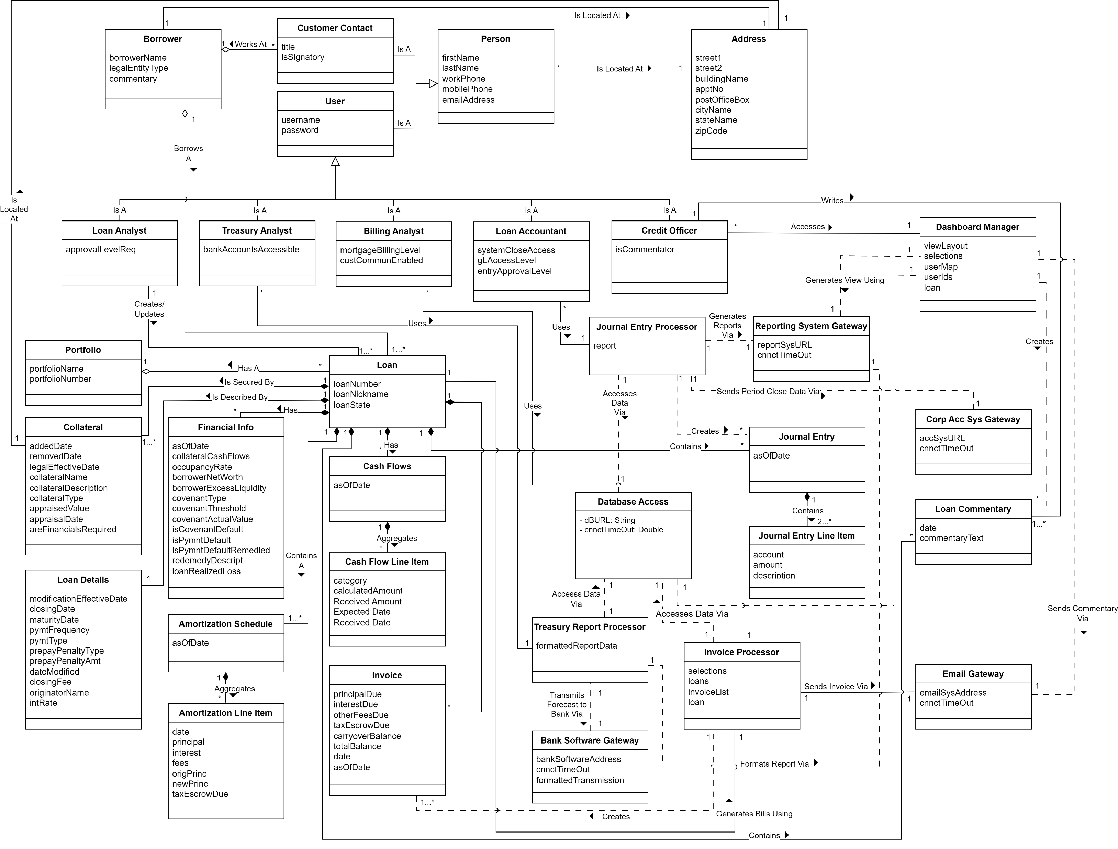
Uml DOMAIN MODEL

Slide 22
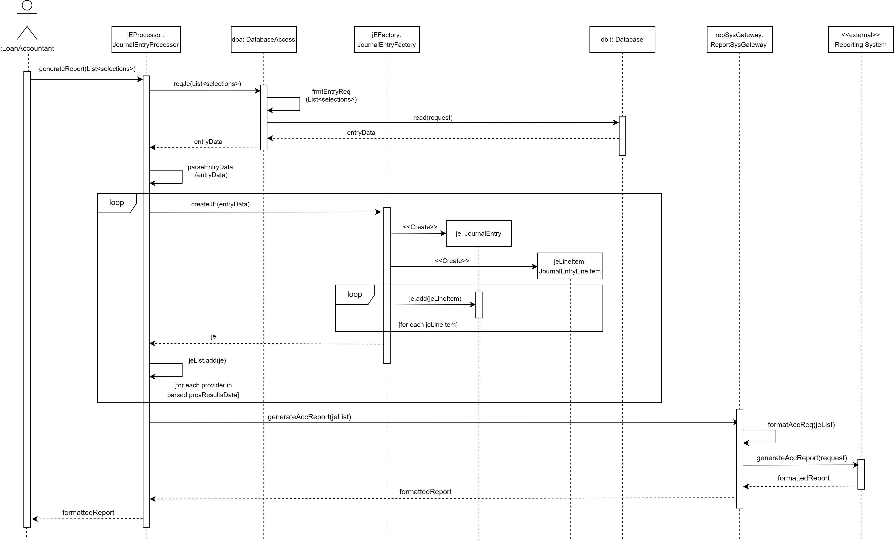
Uml Sequence Diagrams ACCOUNTING REPORT

Slide 23
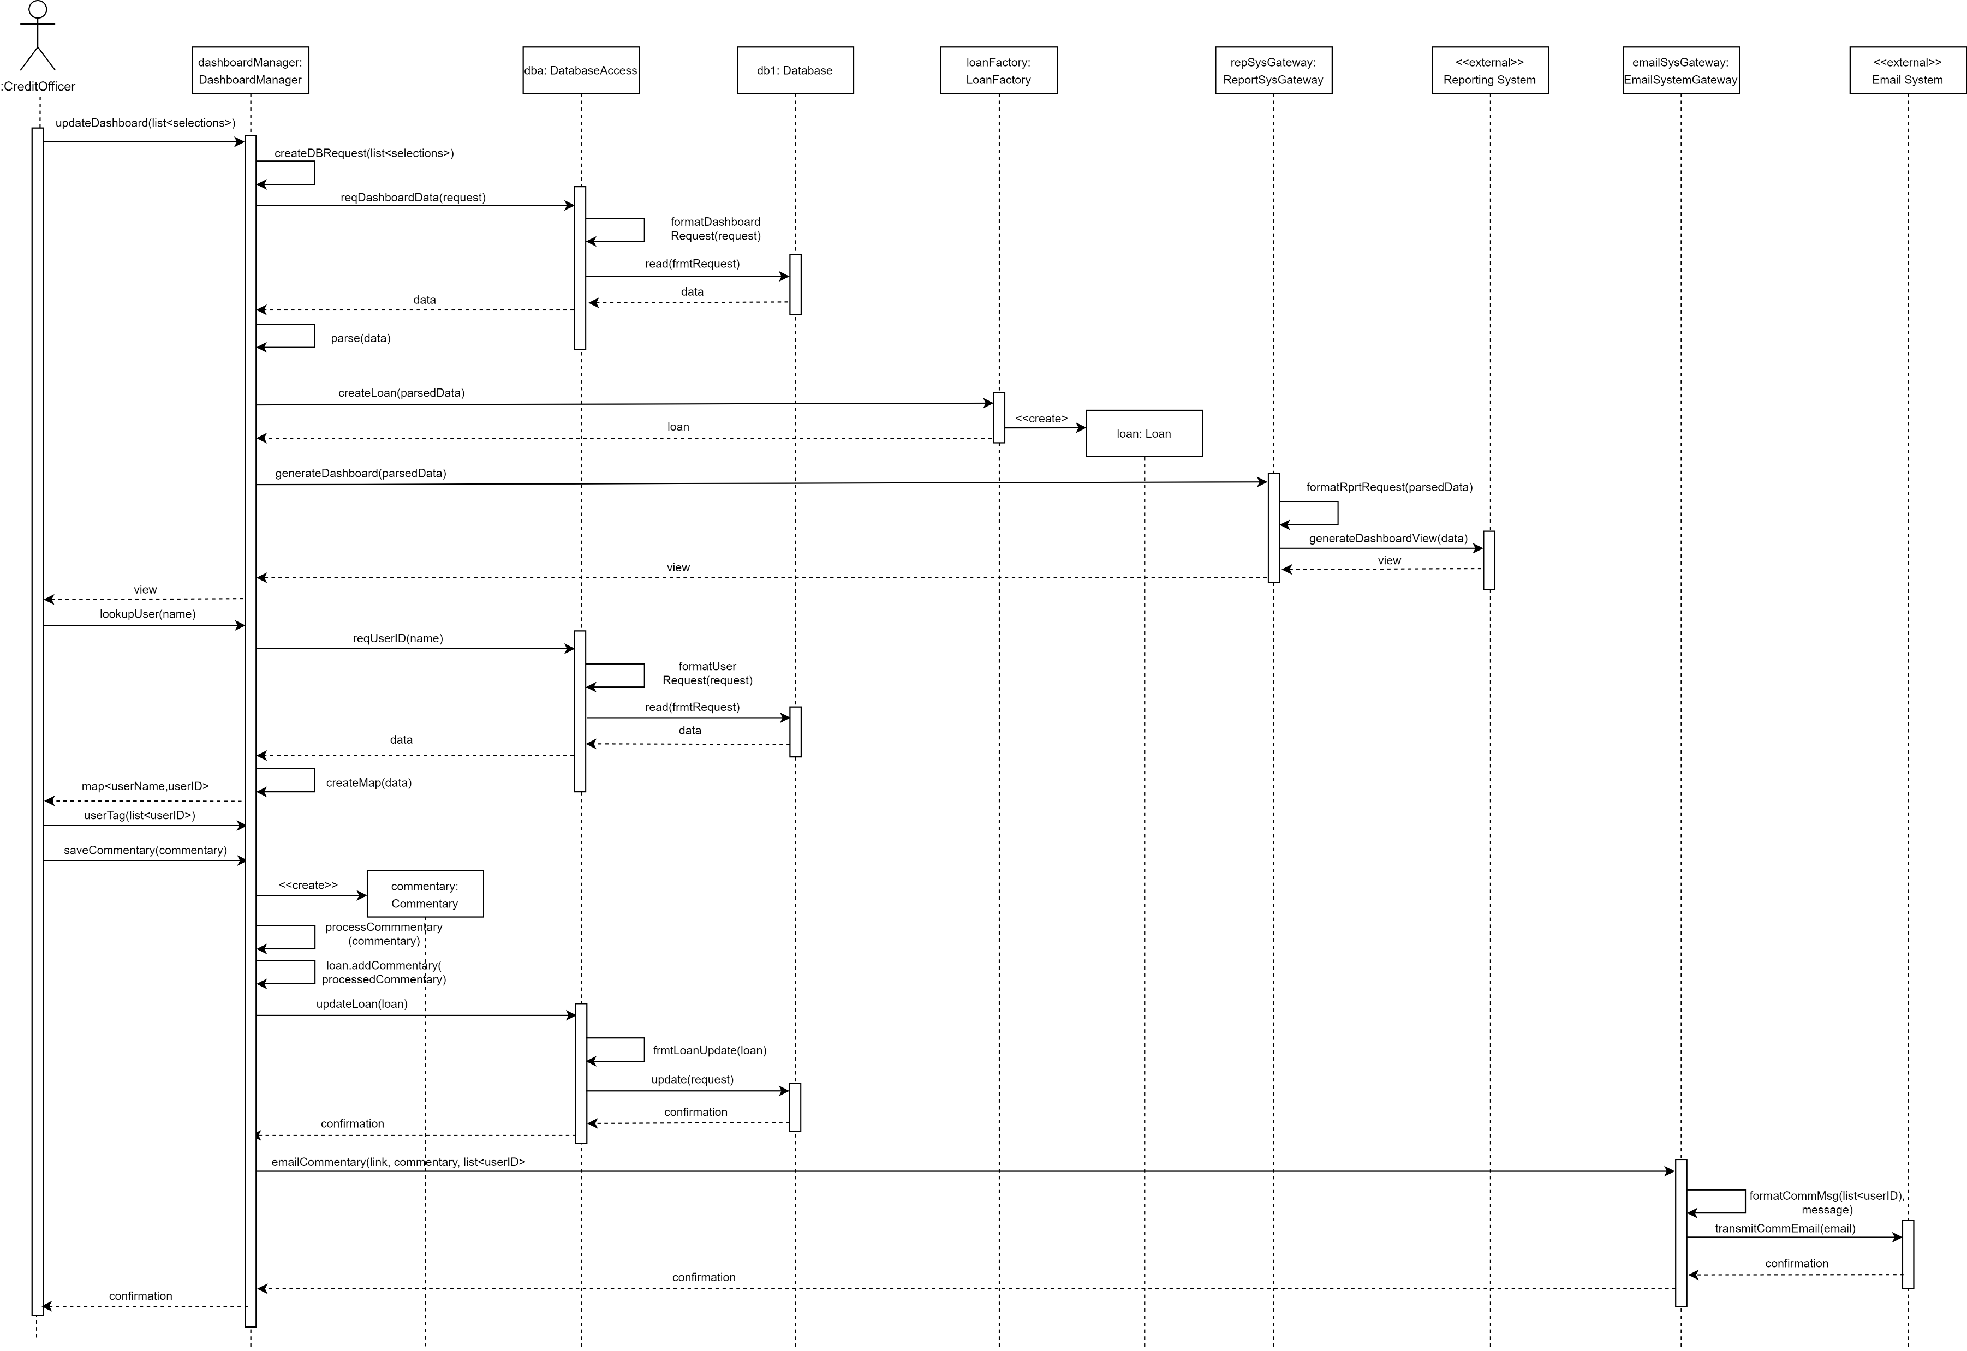
Uml Sequence Diagrams DASHBOARD PROCESSING

Slide 24
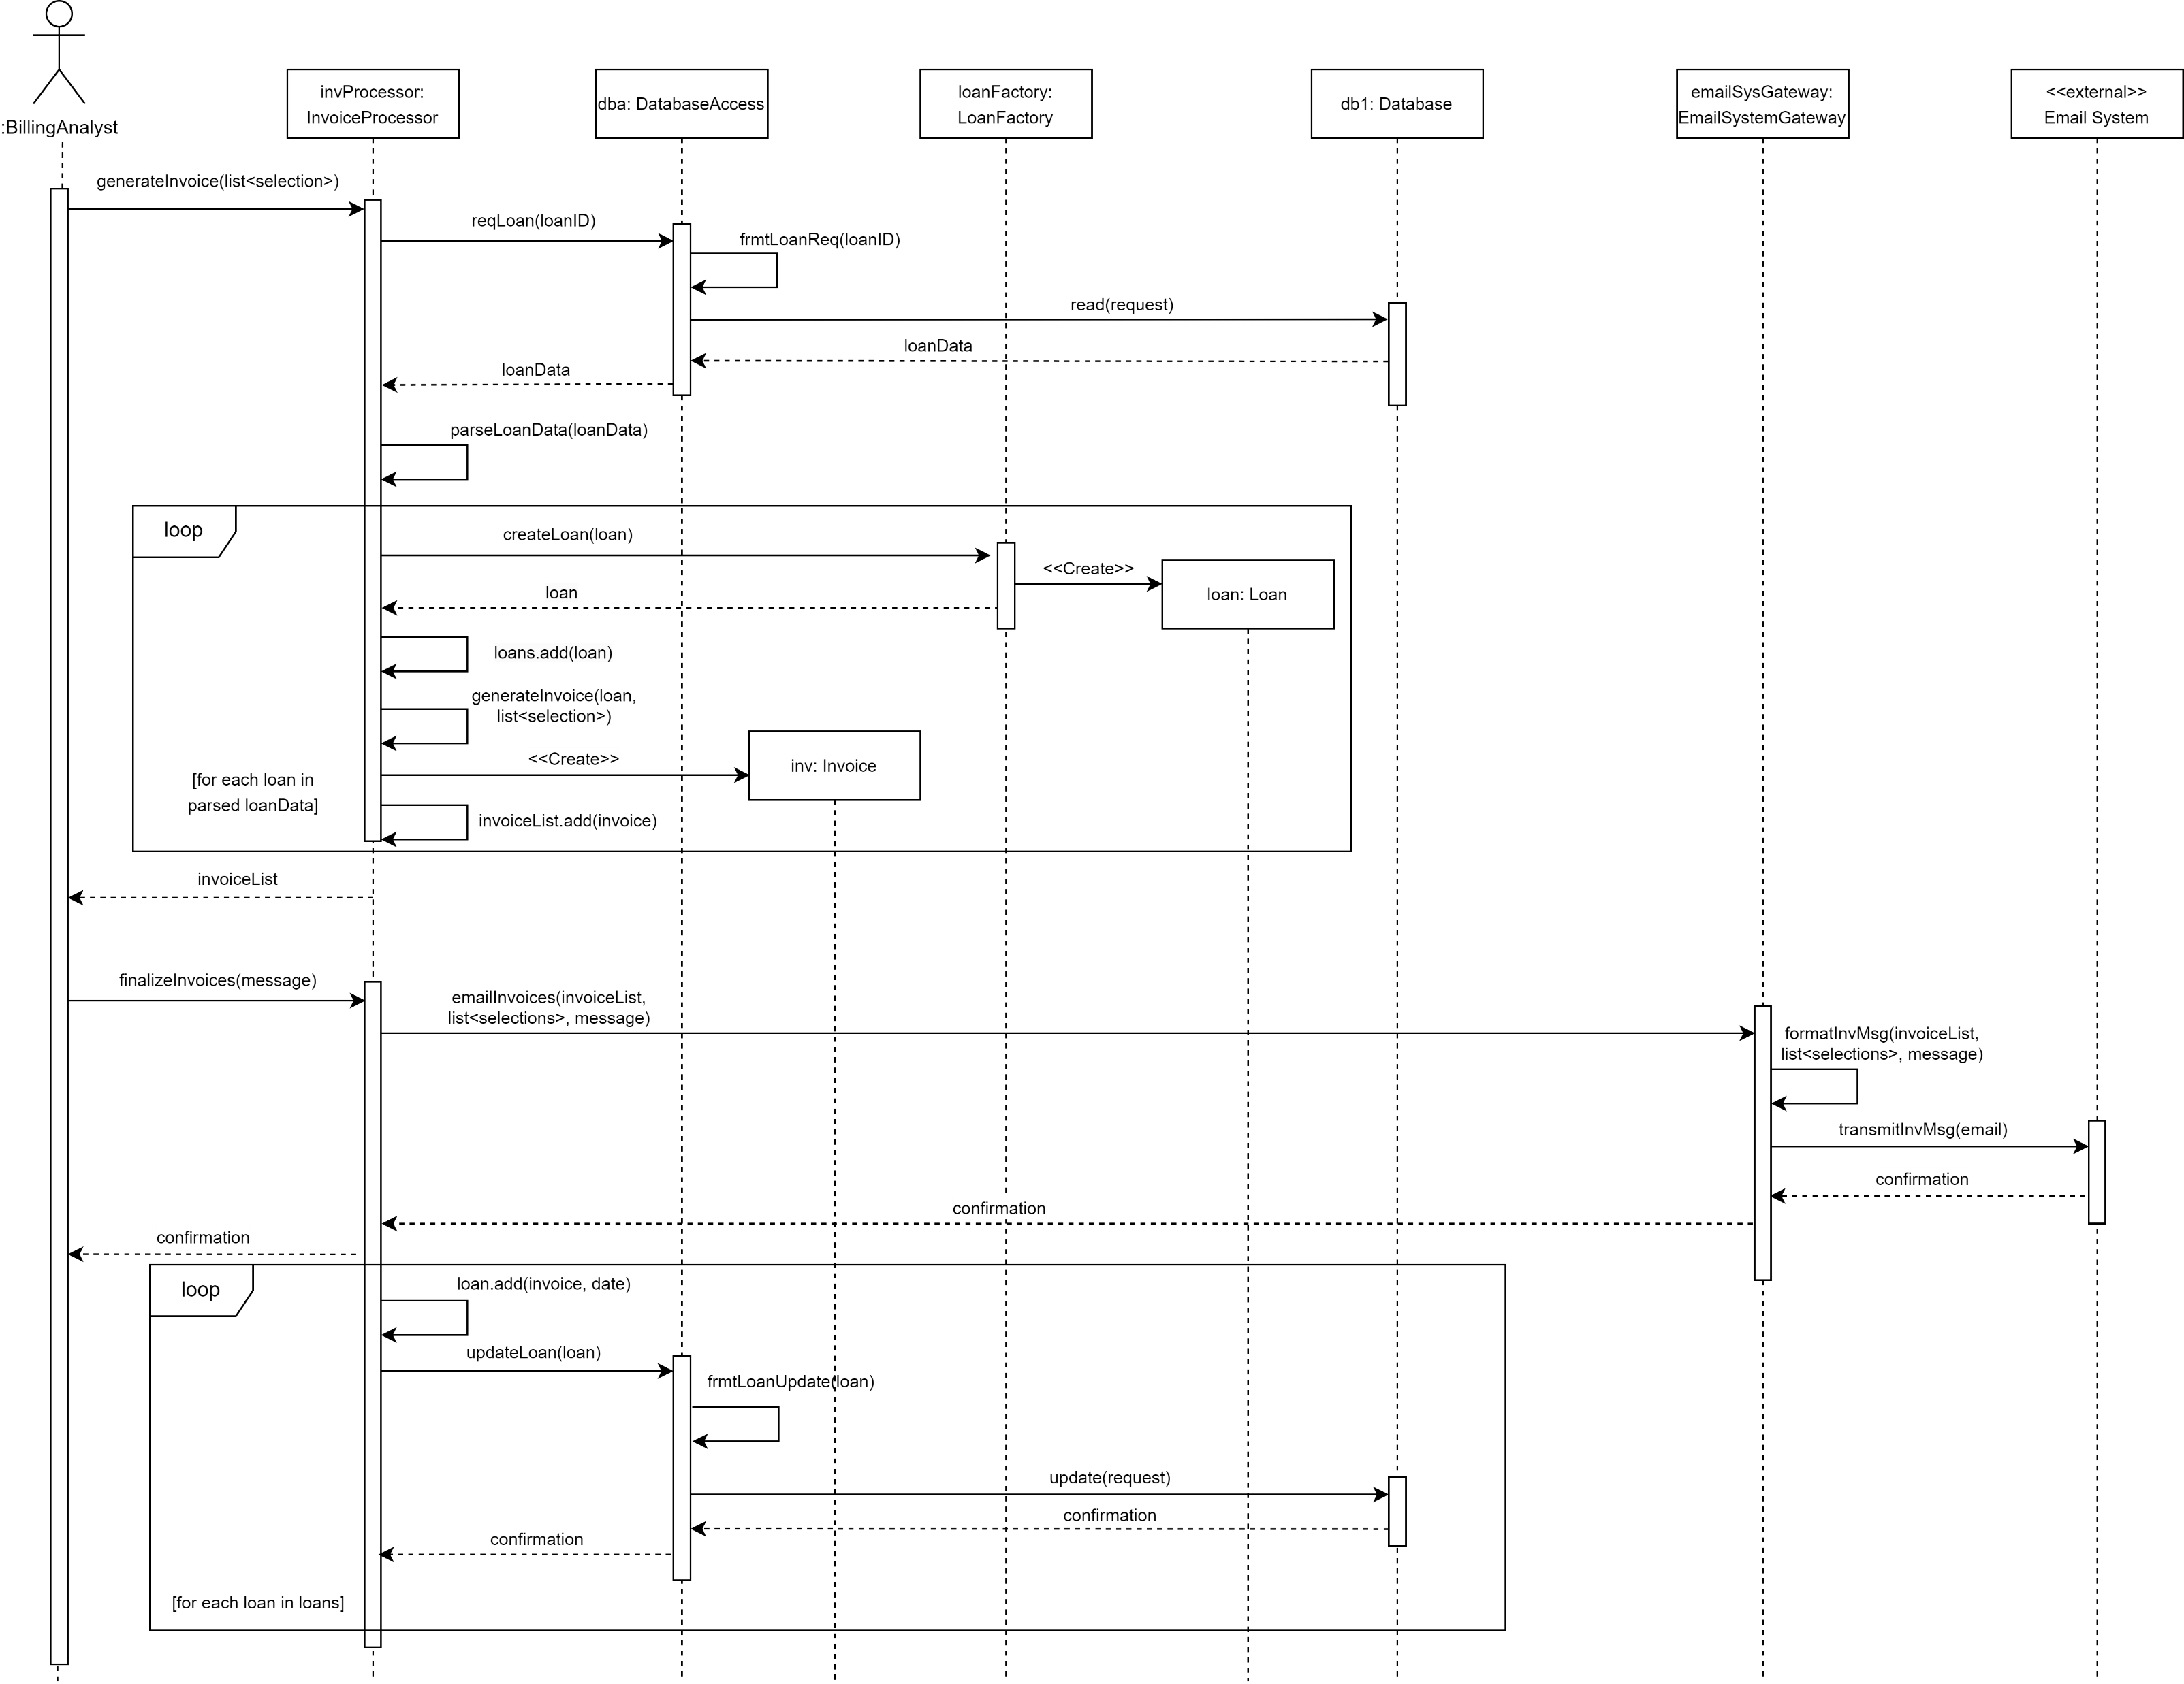
Uml Sequence Diagrams INVOICING

Slide 25
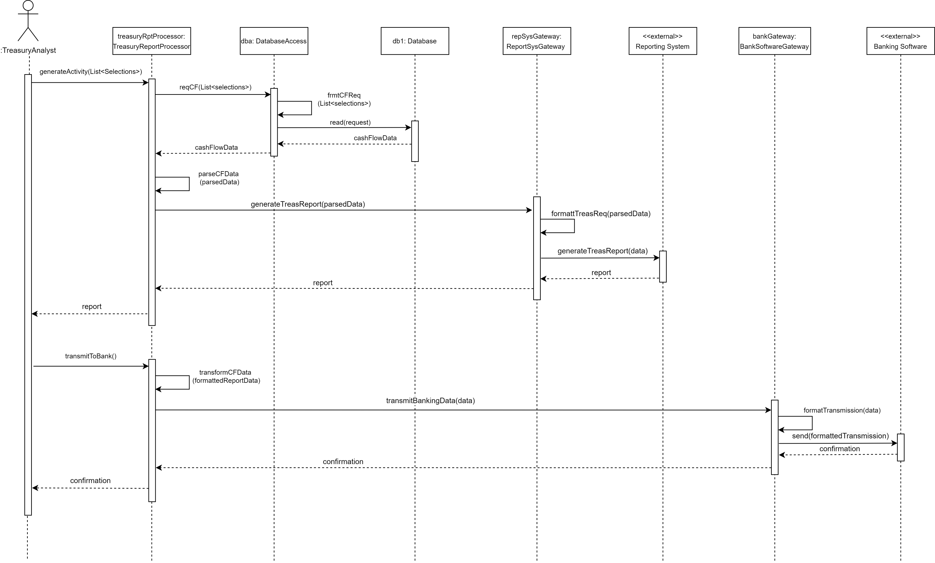
Uml Sequence Diagrams TREASURY CASH ACTIVITY

Slide 26
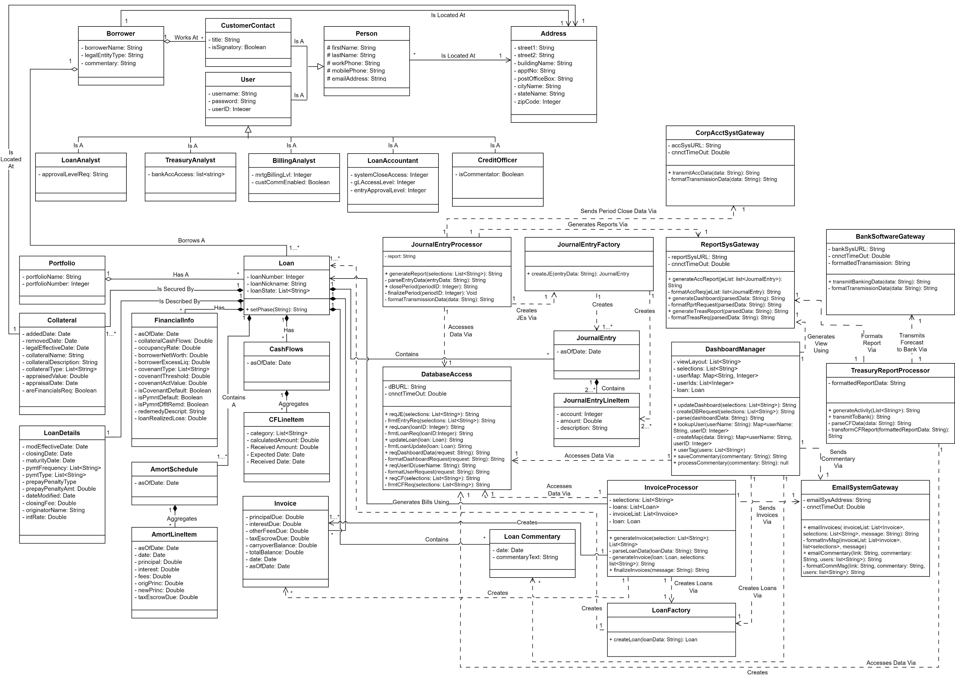
Uml Class diagram

Slide 27
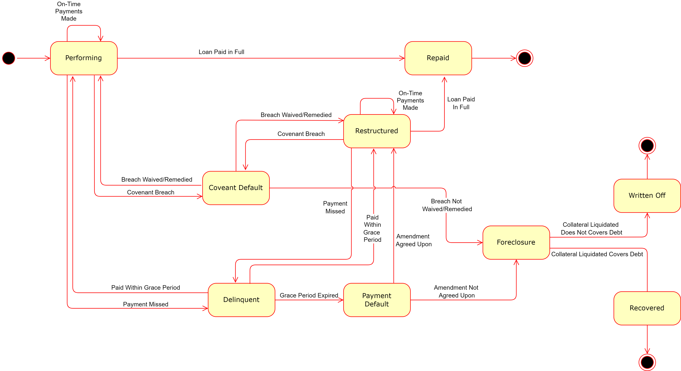
Uml STATE DIAGRAM – LOAN STATES

Slide 28
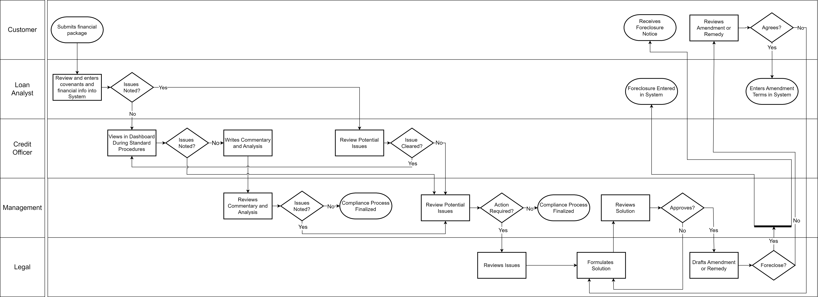
Uml SWIMLANE DIAGRAM – COMPLIANCE PROCESS

Slide 29
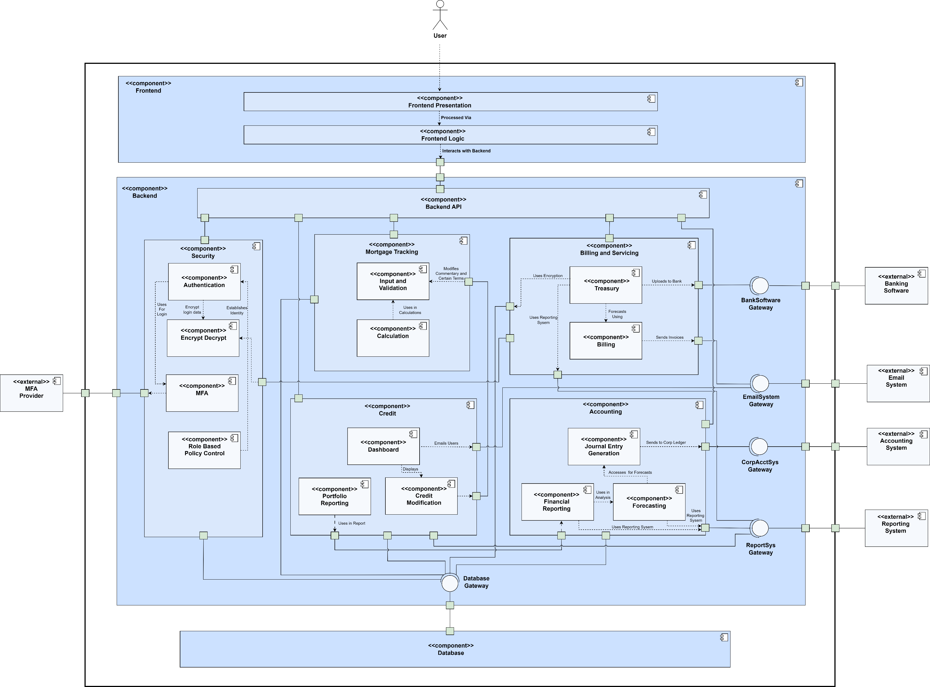
Uml COMPONENT DIAGRAM

Slide 30
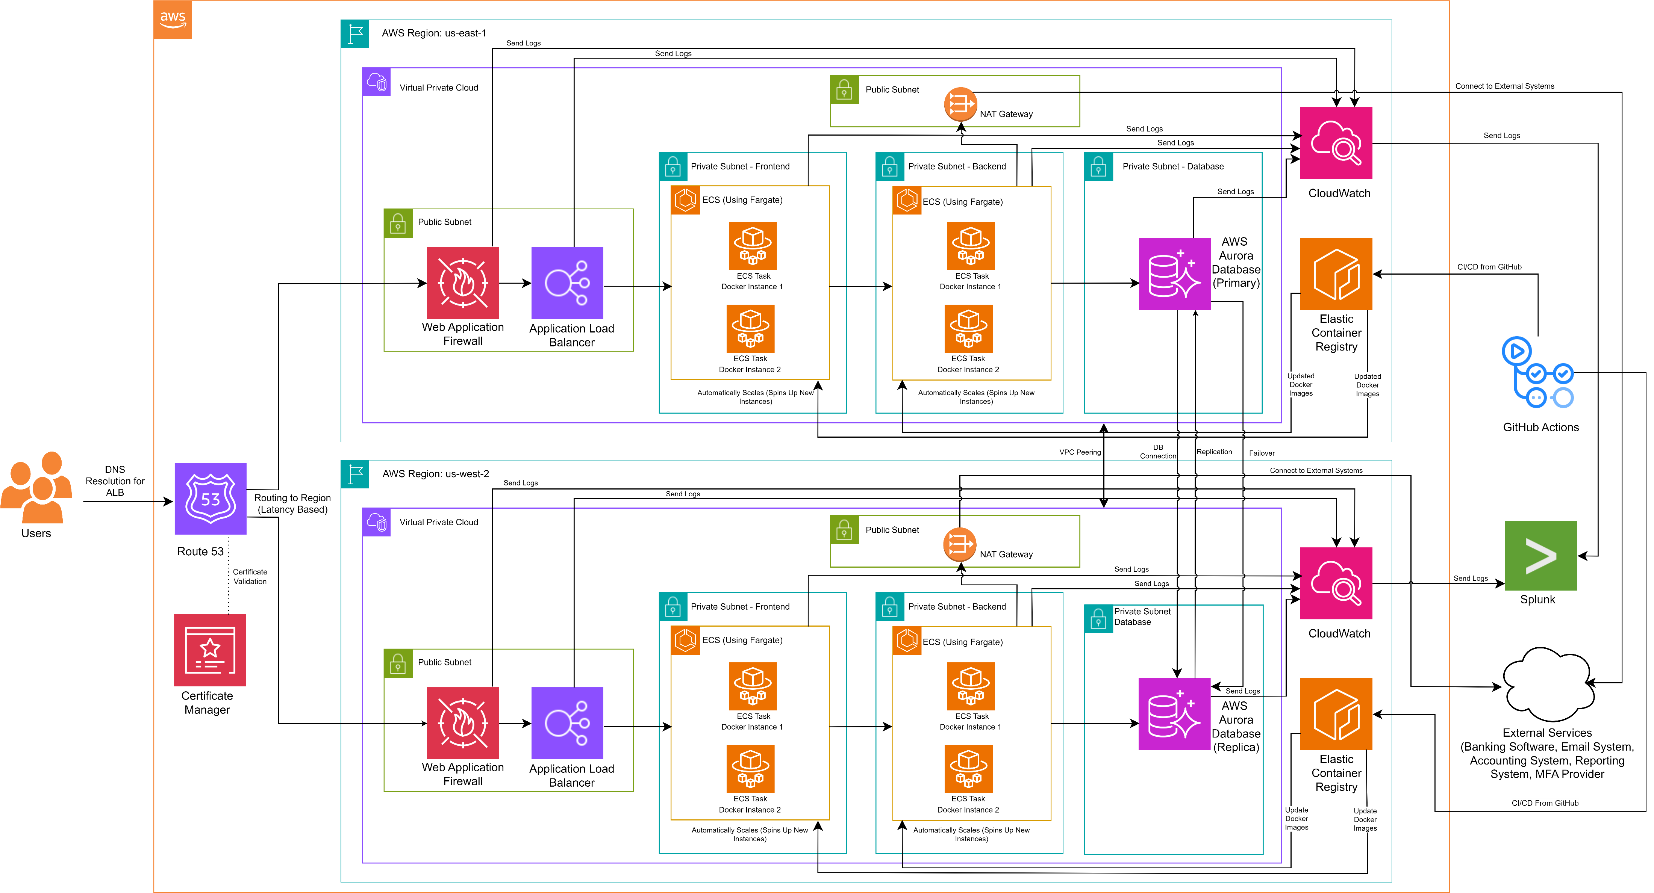
AWS CLOUD DEPLOYMENT DIAGRAM

Slide 31
SKELETON CLASSES
See GitHub Readme.md file for links to Skeleton Classes

Slide 32
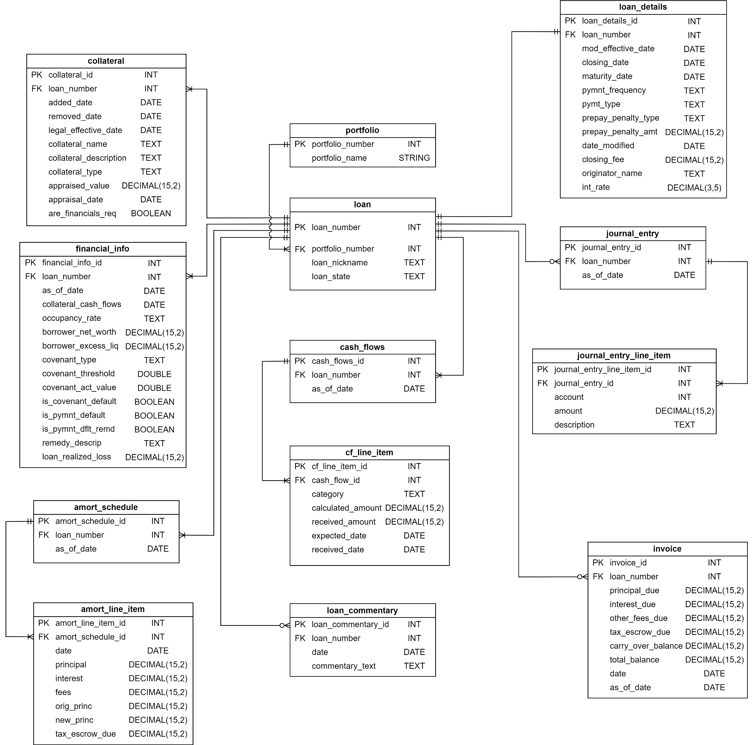
DATABASE TABLE DEFINITIONS

Slide 33
DESIGN PATTERNS
Design Patterns | Implementation Location
Pure Fabrication and Indirection Patterns (GRASP) | “Gateway” Classes, DatabaseAccess, JournalEntryProcessor, InvoiceProcessor, and DashboardManager
Simple Factory Pattern | LoanFactory and JournalEntryFactory
Single Responsibility Principal (SOLID), High Cohesion and Low Coupling (GRASP) | Throughout (Helped by introducing above classes)
Singleton Pattern (GOF) | Demonstrated in Skeleton classes Appropriate for many classes in design, including “Gateway” classes and DatabaseAccess
Three-Tier Architecture | UML Component Diagram, Cloud Deployment Diagram
Data Replication Design Pattern | Cloud Deployment Diagram
Well-Architected Framework Pillars | Throughout (With a focus on Operational Excellence, Security, Reliability, and Performance Efficiency)

Slide 34
Conclusion
Lessons Learned
UML
Object Oriented Design Concepts
AWS Architecture
Full Picture of Systems Design
Career Benefits
Thanks for Watching

Slide 35
References
Larman, C. (2005). Applying UML and Patterns: An Introduction to Object-Oriented Analysis and Design and Iterative Development (3rd ed.). Pearson.
IBM. (n.d.). Three-tier architecture. Retrieved February 26, 2025, from https://www.ibm.com/think/topics/three-tier-architecture
GeeksforGeeks. (2024, July 23). Security in distributed system. Retrieved February 26, 2025, from https://www.geeksforgeeks.org/security-in-distributed-system/#authentication-mechanisms-in-distributed-system
Martin, R. (1996). Class design principles. Object Mentor.
Amazon Web Services. (n.d.-a). AWS Web Application Firewall (WAF). AWS. Retrieved February 27, 2025, from https://aws.amazon.com/waf/
Amazon Web Services. (n.d.-b). What is an Application Load Balancer? - Elastic Load Balancing. Retrieved February 27, 2025, from https://docs.aws.amazon.com/elasticloadbalancing/latest/application/introduction.html
Amazon Web Services. (n.d.-c). Service Auto Scaling for Amazon ECS. AWS Documentation. Retrieved February 27, 2025, from https://docs.aws.amazon.com/AmazonECS/latest/developerguide/service-auto-scaling.html
Amazon Web Services. (n.d.-d). Amazon Aurora. AWS. Retrieved February 27, 2025, from https://aws.amazon.com/rds/aurora/
Chisel Labs. (2023, June 19). What is non-functional requirements? Chisel Labs. Retrieved March 1, 2025, from https://chisellabs.com/glossary/what-is-non-functional-requirements/
GeeksforGeeks. (2025, February 1). Non-functional requirements in software engineering. Retrieved March 1, 2025, from https://www.geeksforgeeks.org/non-functional-requirements-in-software-engineering/
Dilmegani, C., & Alp, E. (2025, February 22). Key components of firewall compliance: Guidance in 2025. AIMultiple. Retrieved March 1, 2025, from https://research.aimultiple.com/firewall-compliance/
Sree. (2020, August 16). Non-functional requirements basics. Technical Program Management. Retrieved March 1, 2025, from https://technicalprogrammanager.com/non-functional-requirements-basics/
Lenovo. (n.d.). Modularity: What is it and how does it enhance business productivity? Retrieved March 1, 2025, from https://www.lenovo.com/us/en/glossary/modularity/
BrowserStack. (2024, September 22). NFRs: What is Non Functional Requirements (Example & Types). https://www.browserstack.com/guide/non-functional-requirements-examples
OpenText. (n.d.). What is performance testing? OpenText. Retrieved March 1, 2025, from https://www.opentext.com/what-is/performance-testing

